Slide 1
Lab 3
Hierarchical modelling and animation

Slide 2
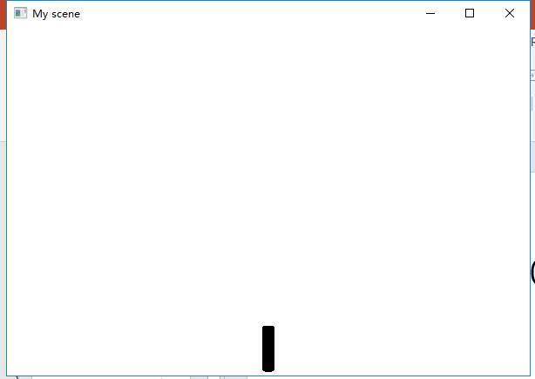
Hierarchical modelling
Tree

Slide 3
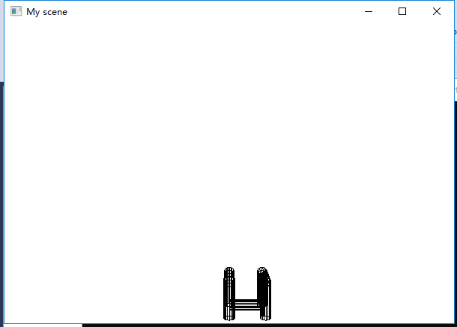
Hierarchical modelling
Turtle

Slide 4
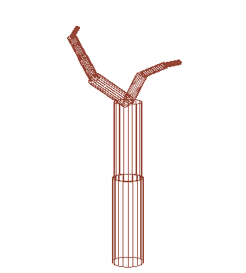
Hierarchical modelling
glPushMatrix()
glPopMatrix()
At “switch” in “MyScene”, add:
case '[': // save
glPushMatrix();
break;
case ']': //restore
glPopMatrix();
break;
At the beginning of “branch” in “MyScene”, add:
glPushAttrib(GL_ALL_ATTRIB_BITS);
glColor3f(0.58f, 0.27f, 0.21f);
At the end of “branch”, add:
glPopAttrib();
Change the code:
string sequence = "ff-[-& f + ff + < +f] + [+>f--f&-f]";
float angle = 22.5f;
Before each “branch()”, add:
glScalef(0.9f, 0.9f, 0.9f);

Slide 5
Hierarchical modelling
In “Tree.cpp”, add:
void Tree::getSequence()
{
int gen = 0, j = 0;
string next;
bool changed;
sequence = init;
char curr;
while(gen<iter){
next = "";
for (unsigned int i = 0; i < sequence.size(); i++) {
curr = sequence[i];
changed = false;
j = 0;
for (vector<char>::iterator it = flags.begin(); it != flags.end(); ++it, j++) {
if (curr == *it) {
next += change[j];
changed = true;
break;
}
}
if (!changed)
next += curr;
}
sequence = next;
gen++;
}
}
In “Tree.h”, add:
#include <vector>
// in public:
void getSequence();
void addReplaceString(char flag, string str);
void setReplaceString(char flag, string str);
void setNumIter(unsigned int num);
void setInitString(string str);
//in private
int iter = 2;
string init = "f";
vector<string> change;
vector<char> flags;

Slide 6
In “Tree.cpp”, add:
void Tree::addReplaceString(char flag, string str)
{
flags.push_back(flag);
change.push_back(str);
getSequence();
}
void Tree::setReplaceString(char flag, string str)
{
flags.erase(flags.begin(), flags.end());
change.erase(change.begin(), change.end());
flags.push_back(flag);
change.push_back(str);
getSequence();
}
void Tree::setNumIter(unsigned int num)
{
iter = num;
}
void Tree::setInitString(string str)
{
init = str;
}

Slide 7
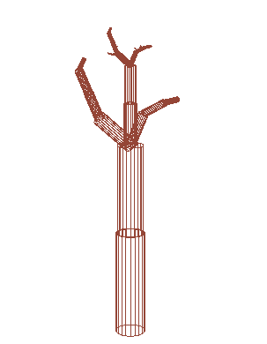
Hierarchical modelling
At “setup()” in “MyScene.cpp”, add:
tree->setReplaceString('f', "ff-[-& f + ff + < +f] + [+>f--f&-f]");

Slide 8
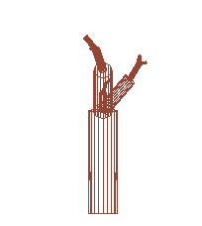
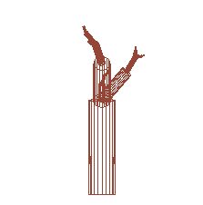
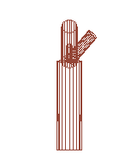
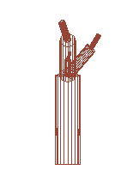
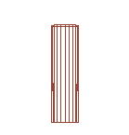
At “setup()” in “MyScene.cpp”, add:
tree->setInitString("F");
tree->setNumIter(2);
tree->setReplaceString('F', "^fG>>>G>>>>>G");
tree->addReplaceString('G', "[^^f>>>>>>F]");
N=1
N=2
N=3
N=4
N=5

Slide 9

Animation
Animation.h
DisplayableObject.h
Horse.h
MyScene.h
Tree.h
Horse.cpp
MyScene.cpp
Tree.cpp

